Slide 1
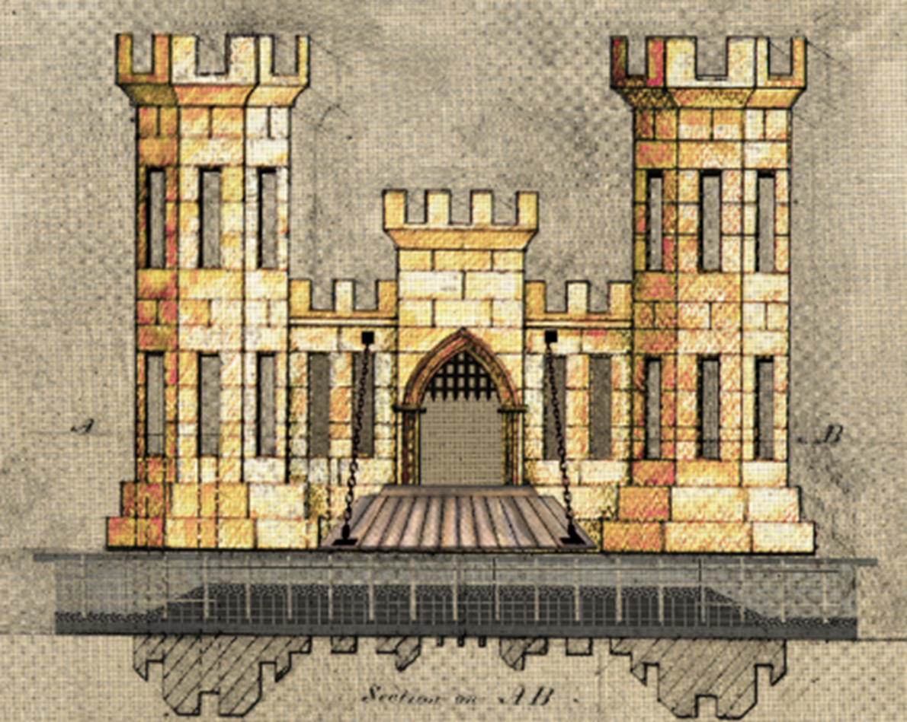
Program Overview “North to the Future”
John Raso
*Chief, Military Branch, Programs and
Project Management Division
Jim Jeffords
*Chief, Construction & Operations Division
James Sauceda
*Chief, Engineering Division
Michelle Mandel
* Deputy, Contracting Division
Ryan Zachry
*Small Business Professional
Alaska District
U.S. Army Corps of Engineers
11 April 2024

Slide 2
MILITARY CONSTRUCTION OPPORTUNITIES FISCAL YEAR 2024-27
PROJECT / LOCATION | VALUE | EXECUTION STRATEGY | CONTRACT TYPE | SOLICITATION TARGET | AWARD TARGET
Army National Guard Readiness Center, JBER | $55M - $70M | D/B, AE | Unrestricted | 4QFY24 | 1QFY25
F-22 Fuels System, JBER | $45M - $55M | D/B/B, AE | Unrestricted | 4QFY24 | 2QFY25
Automated Multipurpose Machine Gun Range, Fort Wainwright | $20M - $25M | D/B/B, AE | Set Aside | 1QFY25 | 1QFY25
Fuels Laboratory, Eielson AFB | $10M - $15M | D/B/D, AE | Set Aside | 1QFY25 | 2QFY25
Joint Integrated Testing and Training Center, JBER | $250M - $400M | D/B/B, AE | Unrestricted | 1QFY25 | 3QFY25
AKARNG Maintenance Hangar | $70M - $85M | D/B/B, AE | Unrestricted | 2QFY25 | 3QFY25
Sand Storage Facility, JBER | $8M-$10M | D/B/B, IH | TBD | 2QFY25 | 3QFY25
Barracks, Fort Wainwright | $125M - $140M | D/B, AE | Unrestricted | 4QFY25 | 1QFY26
Red Flag JPARC Facility, Eielson AFB | $75M - $100M | D/B/B, AE | Unrestricted | 2QFY26 | 3QFY26
AKANG Base Supply Complex, JBER | $40M - $50M | D/B/B, AE | Unrestricted | 3QFY26 | 4QFY26
HC-130J Simulator, JBER | $15M-$20M | TBD | TBD | 3QFY27 | 4QFY27

Slide 3
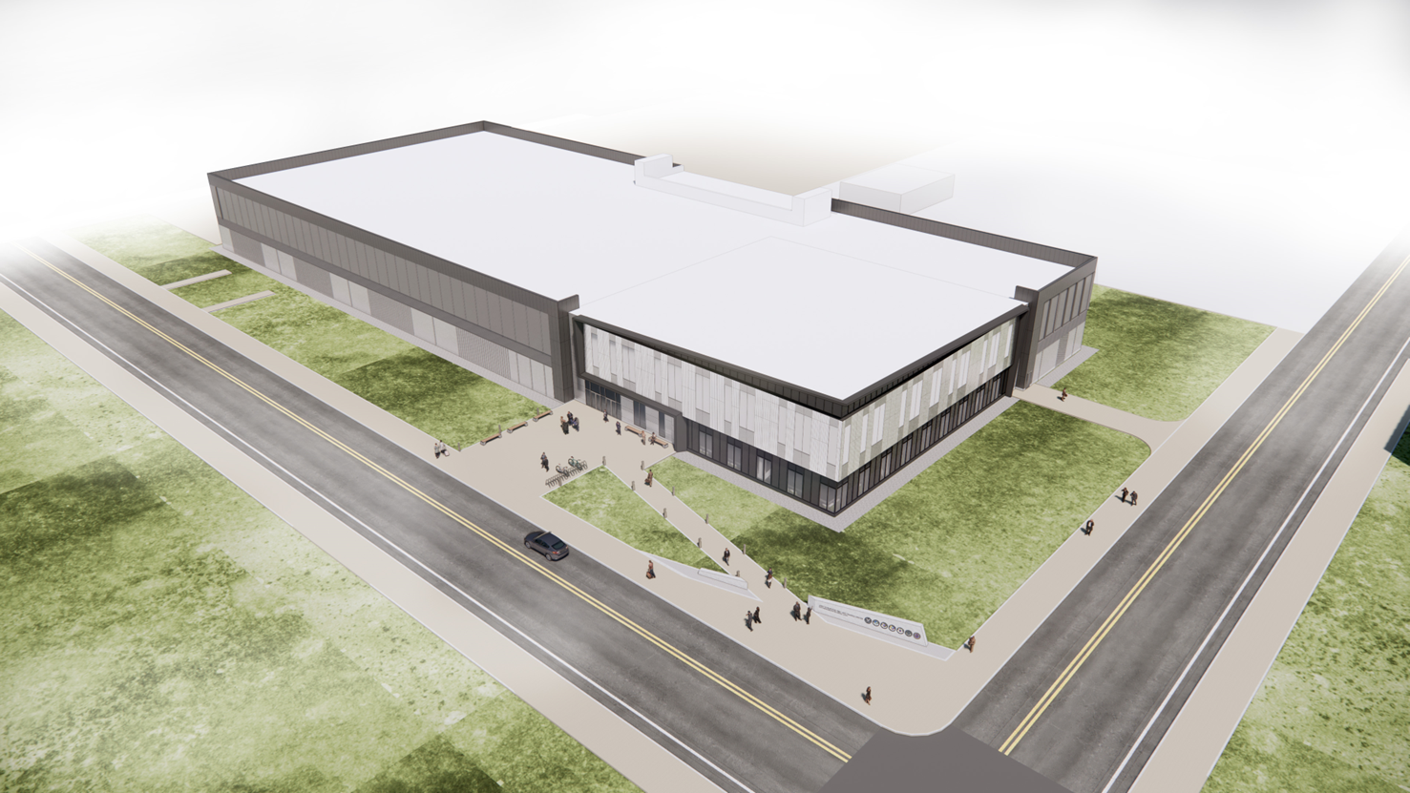
Joint integrated testing & training center Jber, Alaska
Value: $250M - $400M
Target Award: 3QFY25
Type of work: SCIF and security
Major Scope Tasks
Spaces include 118,536 square-feet of Sensitive Compartmented Information Facility (SCIF) spaces.
10 simulator rooms
Briefing rooms
Mission operation centers
A central server room
An auditorium for 200 persons
Administrative space
The JITTC Flight Simulator Training Facility is a 150,852 gross square-foot two-story structure with reinforced concrete foundations, structural steel frame, insulated steel panel and masonry walls, and standing seam metal and membrane roof.

Slide 4
Sustainment, restoration, and modernization FISCAL YEAR 2024-25
PROJECT / LOCATION | VALUE | EXECUTION STRATEGY | CONTRACT TYPE | SOLICITATION TARGET | AWARD TARGET
Missile Field 3 Power Redundancy, Fort Greely | $5-10M | D/B/B, AE | 8(a) Set Aside | 3QFY24 | 4QFY24
Life Safety Repairs Building 1557, Fort Wainwright | $7M – $10M | D/B, AE | Set Aside | 4QFY24 | 4QFY24
Repair Site Fire Alarm System, Eareckson AS | $15M - $20M | D/B/B, AE | Set Aside | 3QFY25 | 4QFY25
11th ABN Building 1 Renovation, JBER | $100M - $150M | D/B, AE | Unrestricted | 3QFY25 | 4QFY25
Repair Arctic Utilidor Ph D-2, Eielson AFB | $15M - $18M | D/B, AE | Set Aside | 3QFY25 | 4QFY25
IDT1 Facility UPS System Replacement, Fort Greely | $3-5M | D/B/B, AE | Set Aside | 3QFY25 | 4QFY25
11th ABN Building 652 Renovation, JBER | $100M - $150M | D/B, AE | Unrestricted | 3QFY25 | 4QFY25
Attu Hall Renovation, JBER | $25M - $35M | D/B/B, AE | Unrestricted | 3QFY25 | 4QFY25
Mechanical Electrical Building 2 Chiller Replacement, Fort Greely | $3-5M | D/B/B, AE | Set Aside | 3QFY25 | 4QFY25
Missile Field 2 Power Redundancy, Fort Greely | $5-10M | D/B/B, AE | Set Aside | 3QFY25 | 4QFY25
Readiness & Control Building 80 kVA UPS(s) Replacement | $5-10M | D/B/B, AE | Set Aside | 3QFY25 | 4QFY25
Mechanical Electrical Buildings 2&3 Rockwell Panel Replacement | $5-10M | D/B/B, AE | Set Aside | 3QFY25 | 4QFY25

Slide 5
Civil Works CONSTRUCTION OPPORTUNITIES FISCAL YEAR 2024-27
PROJECT / LOCATION | VALUE | EXECUTION STRATEGY | CONTRACT TYPE | SOLICITATION TARGET | AWARD TARGET
Nome Port Modifications Phase 1, Nome | $250M - $500M | D/B/B, IH | Unrestricted | 2QFY24 | 4QFY24
Unalaska Dutch Harbor, Unalaska | $20M - $30M | D/B/B, IH | Constr Not Yet Funded | 3QFY24 | 4QFY24
St George Navigation Improvements * | $100M - $150M | D/B/B, AE | Constr Not Yet Funded | TBD | TBD
Nome Port Modifications Phase 2, Nome* | $50M - $100M | D/B/B, IH | Unrestricted | 2QFY25 | 3QFY25
Elim Navigation Improvements, Elim* | $70M - $90M | D/B/B, AE | TBD | 3QFY25 | 4QFY25
Lowell Creek – Flood Diversion System, Seward* | $150M - $200M | D/B/B, IH | Unrestricted | 3QFY26 | 4QFY26
Nome Port Modifications Phase 3, Nome* | $100M - $150M | D/B/B, IH | Unrestricted | 4QFY26 | 1QFY27

Slide 6
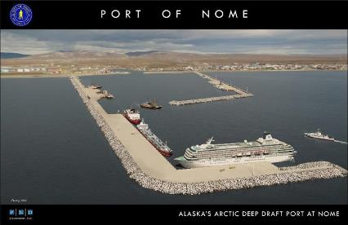
Nome Port Modifications, Nome Alaska
Three Phase Construction
Phase | Value | Target Award | General Scope
Phase 1 | $250M - $500M | 4QFY24 | West Causeway extension
Phase 2 | $50M - $100M | 2QFY25 | Dredging of basin
Phase 3 | $100M - $150M | 4QFY26 | East Breakwater realignment
The project would construct a new deep-water basin to a depth of -40 feet (ft) mean lower low water (MLLW), deepen the outer basin from -22 ft MLLW to -28 ft MLLW, extends the west causeway by 3,484 ft and constructs 2,000 ft of useable dock moorage area, removal of the existing west breakwater, construction of a 3,900 ft east causeway/breakwater, and construction of 400 ft long docks in the outer basin on the east causeways.
Major Scope Tasks
Construct ~3500 feet of causeway extension with 18 ton well keyed armor
Construct approx. 2000 feet of open cell sheet pile dock face
Dredge basin to -40 ft MLLW
Disassemble existing East breakwater and construct new East breakwater

Slide 7
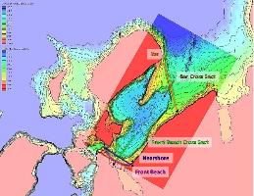
Unalaska Dutch Harbor, Unalaska
Value: $20M - $30M
Target Award: 4QFY24
Type of work: Deep water dredging
The project will provide a 600’ x 600’ dredged channel with a depth of -58’ MLLW. Material dredged is estimated at 172,000 cy to max over depth of -60’MLLW. The dredged channel will remove a bar creating a navigation hazard to the Dutch Harbor entrance.
Scope Tasks
Dredge approx. 172,000 cubic yards of material to a maximum depth of -60 feet
Disposal site adjacent to dredge prism

Slide 8
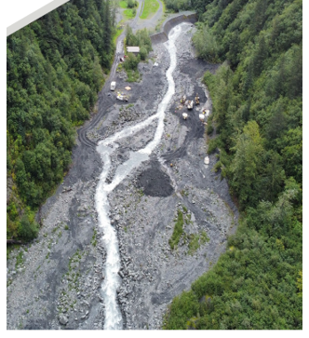
Lowell Creek – Flood Diversion System, Seward
Value: $150M - $200M
Target Award: 4QFY26
Type of work: Diversion structure and tunnel construction
The new flood diversion project would reduce the risk to life safety to the City of Seward posed by flood events from Lowell Creek. The project would construct a new 18-foot diameter tunnel capable of diverting flow of 8,500 cubic feet per second 150-foot-long tunnel outfall over Lowell Point Road, and refurbishment of the existing tunnel liner.
Major Scope Tasks
Construct concrete lined diversion/inlet channel
Construct concrete bypass diversion structure
Tunnel approximately 2000 linear feet of 18 foot diameter tunnel
Construct outfall flume structure

Slide 9
environmental OPPORTUNITIES FISCAL YEAR 2024
PROGRAM / PROJECT | VALUE | Execution Strategy | CONTRACT TYPES | SOLICITATION TARGET | AWARD TARGET
Army and Air Force Environmental Restoration Programs | $15M | AE or Env Services | Various | 2Q-3QFY24 | 3Q and 4QFY24
Formerly Used Defense Sites (FUDS) Program | $16M | AE or Env Services | Various | 1Q-3QFY24 | 3QFY24
Army and Air Force Compliance/Quality Programs | $45M | AE or Env Services | Various | 2Q-3QFY24 | 3Q and 4QFY24
Interagency Environmental Program | $6M | AE or Env Services | Various | 3QFY24 | 4QFY24
Environmental Quality Support Services (MATOC) | $48M | Services | Small | 3QFY24 | 4QFY24

Slide 10
UPDATES FROM construction
RMS Replacement – Construction Management Platform (CMP) - Contract to be awarded by end of FY24 and expect to begin deploying the new system within two years of contract award.
CQM-Course – 1st online course was conducted on 2-3 Apr. The last training until the fall will be online 7-8 May and in person on 9-10 May at UAA Aviation Building, Merrill Field. We will be setting up a schedule for next fall.
Partnering – Improved communications and issue resolution. Strive for open and honest communications. Engage even if not part of formal contract requirements. Start early and include all levels of the project team. Escalation ladders are a best practice.
Issue Resolution – REAs and Claims only get more complicated and less clear with time. Elevate these EARLY which will greatly expedite decisions.
Organizational Changes – next slide.

Slide 11
construction and operations division
Jim Jeffords
Chief, Construction and Operations
Karey Park
Chugach Area Office
Mark Kelliher
Denali Area Office
Geoffrey Ries
Civil Works / EAR
Andrew Posma
Fort Wainwright
Colleen Jordan
JBER
John Dutton
Eielson
Matt Folk
Moose Creek Dam
Brad Bradley
Fort Greely
Rolf Ness
JBER Runway

Slide 12
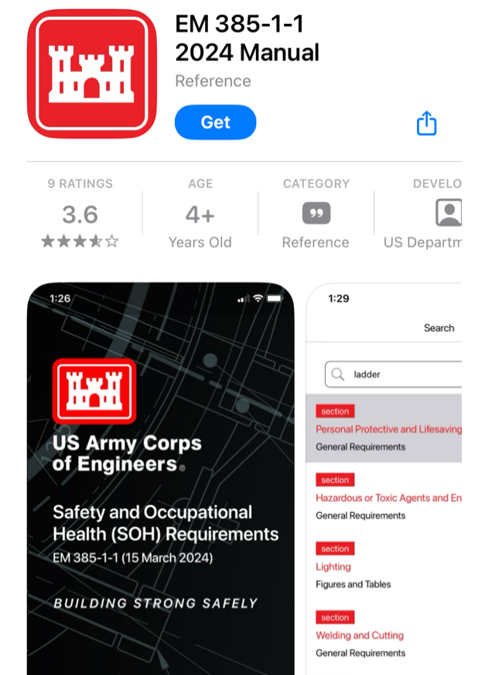
UPDATES ON SAFETY
Safety Helmets
New Safety Manual
Current Accidents vs FY2023
https://www.usace.army.mil/missions/safety-and-occupational-health/

Slide 13
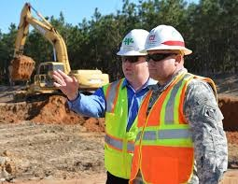
Engineering best practices
Construction Quality starts with Design Quality.
Utilize and implement Design Quality Control Plan (DQCP).
The Designer of Record (DOR) should review and approve submittals before USG submission and remain involved throughout the contract's duration.
Empower the Design Quality Control Manager (DQCM) to uphold quality standards throughout the contract duration.
Prime Contractors need to assure subcontractors receive necessary DOR support.
Maintain healthy and effective partnership through communication, collaboration, and commitment.

Slide 14
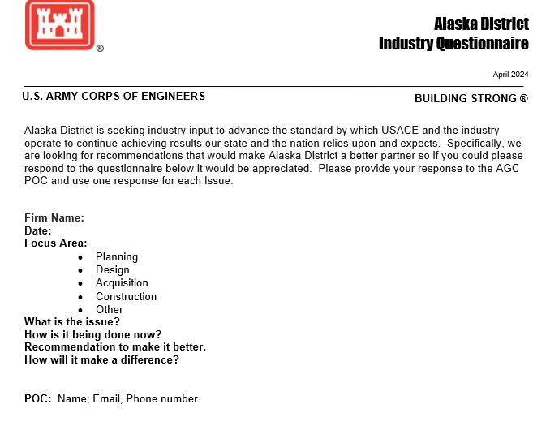
Industry questionnaire
We welcome any questions you have to make Alaska District a better partner.
Please provide your question on our Industry Questionnaire form and submit to the AGC POC.
We will work with you to address the questions.
* Recent Inquiries
(Construction) USACE inconsistency in interpreting contract specifications (Tutka, LLC)
(Design) Digital/Analog system requirements are difficult to achieve (Brice Builder, LLC)
(Contracting) Early awareness of future Design-Build projects (Santec)
(Design) CAD Standard discrepancies and incomplete CAD files in RFP’s (Arctic-Sea)
(Contracting) 2 Step DB contract approach –time/cost burden to proposers (RESPEC, LLC)
(Construction) NEW – Difficulty in filling key personnel (e.g. SSHO) to execute projects (Various)

Slide 15
Best practices contracting
Participate in Market Research and Outreach Events
Track SAM.gov (https://sam.gov/) and respond to sources sought notices – for AK District USACE announcements use keyword “W911KB”
Alaska District supports Industry and Government outreach events: AGC, SBA, PTAC and SAME
If you’ve never worked with the Alaska District before, consider –
Subcontracting OR Partnership (JV, Mentor Protégé)
Know the solicitation, Ask questions during solicitation process, Attend site visits
Submit everything that is asked for in solicitation,
Make it as simple for the Government to evaluate your proposal as you can
Communicate freely to resolve issues at the lowest level at the time of their occurrence
FY23 Lessons Learned
Incremental funding – DFARs 252.232-7007, Limitation of Governments Obligation
Budget busts / Funding delays

Slide 16
Project labor agreements (PLA’s)
Executive Order 14063 implementing the new PLA rule is effective for new solicitations entered into on or after 22 January 2024.
Required for large-scale construction projects, with performance in the United States and an anticipated total estimated construction contract value of $35 million or greater. Does not apply to dredging.
Since USACE is not an employer engaged primarily in the building and construction industry, USACE will neither negotiate nor become signatory to a PLA.
At the present time, the Alaska District’s intent is to use the basic version of FAR Clause 52.222-33, Notice of Requirement for Project Labor Agreement, (all offerors required to submit a PLA with their offer); the PLA will be evaluated during the source selection process on an Acceptable/Unacceptable basis.

Slide 17
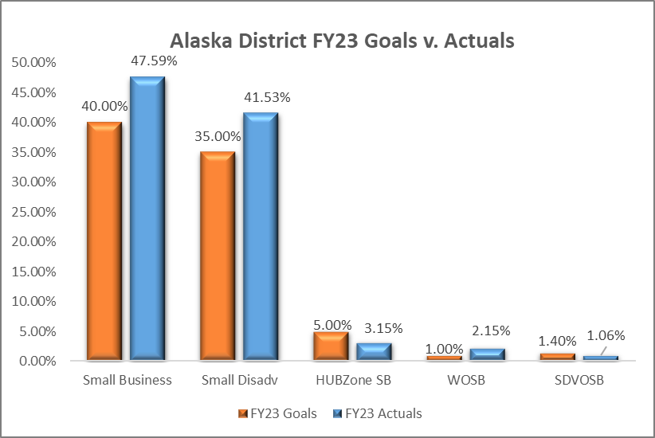
Best practices Small Business Execution
Communicate & Stay up to Date
Participate in Market Research
Keep capabilities statements updated
Long-term Contract Opportunities
(POA SB site below)
USACE Enterprise-wide Upcoming Opportunities:
Procurement Forecast, Calendar,
Resources and more at the Alaska District OSBP site:
https://www.usace.army.mil/Business-With-Us/Small-Business/Upcoming-Contract-Opportunities/
Total SB $ in FY23: $332.4M
https://www.poa.usace.army.mil/Business-With-Us/Office-of-Small-Business-Programs/

Slide 18
USACE POA Small Business WEBSITE

Slide 19
CONTACTS U.S. Army Corps of Engineers – Alaska District
Contracting Division
Deputy, Contracting Division – Michelle Mandel
Phone: 907-753-2502 / Email: Michelle.R.Mandel@usace.army.mil
Civil Works Program
Cooperative Agreements
Chief, Military Branch – Theresa Afrank
Phone: 907-753-2739 / Email: Theresa.M.Afrank@usace.army.mil
Military Construction Program
Missile Defense Program
Chief, Special Projects Branch – George Nasif
Phone: 907-753-2838 / Email: George.G.Nasif@usace.army.mil
Environmental Program
Interagency Program
International Program
Small Business Office
Small Business Professional – Ryan Zachry
Phone: 907-753-5557 / Email: ryan.b.zachry@usace.army.mil

